Slide 1
Atomic Structure: From Philosophical Idea to Quantum Reality
Presented by
Muqaddas Mehfooz

Slide 2
What is an Atom? The Basic Concept
Definition: The smallest unit of ordinary matter that forms a chemical element
Key Properties:
Consists of a nucleus (protons + neutrons) surrounded by electrons
Different elements = different numbers of protons
Diameter: ~0.1-0.5 nanometers (1 nm = 10⁻⁹ m)
Everyday Scale:
A human hair is about 1 million carbon atoms wide
A drop of water contains about 1.5 sextillion atoms (1.5 × 10²¹)
Key Point: Everything you see, touch, and are made of consists of atoms

Slide 3
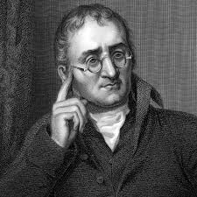
Dalton's Solid Sphere Model (1808)
John Dalton - English Schoolteacher
First scientific atomic theory based on experimental evidence
Five Main Postulates:
All matter composed of indivisible atoms
Atoms of same element are identical in mass/properties
Atoms combine in simple whole-number ratios to form compounds
Atoms cannot be created, destroyed, or subdivided in chemical reactions
Limitations:
No internal structure (atoms as solid spheres)
No knowledge of subatomic particles
Couldn't explain isotopes (atoms of same element with different masses

Slide 4
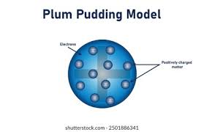
Thomson's "Plum Pudding" Model (1897)
J.J. Thomson's Cathode Ray Experiment (1897):
Discovered electrons - first subatomic particle
Measured charge-to-mass ratio (e/m) of electron
Showed electrons are much smaller than atoms
The "Plum Pudding" Model:
Atom as positive "pudding" spread throughout
Negatively charged electrons embedded like "plums"
First model with internal structure
Key Innovation: Atoms are divisible!

Slide 5
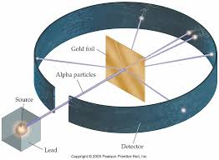
Rutherford’s Nuclear Model (1911)
Gold Foil Experiment (Geiger-Marsden):
Alpha particles (positive) shot at thin gold foil
Expected:
All particles pass through (plum pudding model)
Observed:
Most passed through
Some deflected at large angles
~1 in 8000 bounced straight back!
Rutherford's Conclusions:
Atom is mostly empty space
Positive charge concentrated in tiny nucleus (10⁻¹⁵ m)
Electrons orbit nucleus at distance (10⁻¹⁰ m)
Scale Analogy: If nucleus = marble in center of football stadium, electrons = outer seats
Nuclear Model: Dense nucleus + orbiting electrons (like solar system)

Slide 6
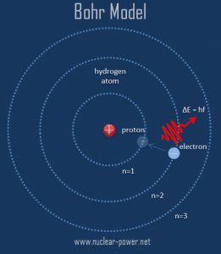
Bohr's Quantum Model (1913)
The Problem with Rutherford's Model:
Accelerating electrons should radiate energy and spiral into nucleus
Couldn't explain discrete atomic spectra
Niels Bohr's Solutions:
Quantized Orbits: Electrons only exist in specific allowed orbits
Stationary States: No radiation while in allowed orbits
Quantum Jumps: Electrons jump between orbits, emitting/absorbing photons
Energy Levels:
Each orbit = specific energy level
Formula: Eₙ = -13.6/n² eV for hydrogen
Explains hydrogen spectrum perfectly
Limitations: Only worked for hydrogen; still semi-classical

Slide 7
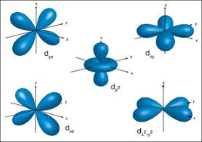
Modern Quantum Mechanical Model
1920s Quantum Revolution:
Schrödinger Equation (1926): Describes electrons as waves
Heisenberg Uncertainty Principle: Cannot know both position and momentum precisely
Wave-Particle Duality: Electrons behave as both particles and waves
Key Concepts:
Electron Clouds: Probability distributions, not fixed orbits
Orbitals: s, p, d, f shapes where electrons are likely found
Quantum Numbers: Describe electron states (n, l, mₗ, mₛ)
Pauli Exclusion Principle: No two electrons can have same quantum state
This Model Explains:
Chemical bonding and periodic table
Complex atomic spectra
All chemical properties

Slide 8
The Standard Model of Particle Physics
MATTER PARTICLES (Fermions - Spin ½)
Everything in the universe is made of these:
QUARKS (Experience all forces)
Generation 1 (Stable Matter):
Up (u) - Charge: +²/₃ | Mass: ~2.2 MeV/c²
Down (d) - Charge: -¹/₃ | Mass: ~4.7 MeV/c² Proton = uud, Neutron = udd
Generation 2 (Unstable):
Charm (c) - Charge: +²/₃ | Mass: ~1.28 GeV/c²
Strange (s) - Charge: -¹/₃ | Mass: ~96 MeV/c²
Generation 3 (Heaviest):
Top (t) - Charge: +²/₃ | Mass: ~173 GeV/c²
Bottom (b) - Charge: -¹/₃ | Mass: ~4.18 GeV/c²

Slide 9
The Standard Model of Particle Physics
LEPTONS (No strong force)
Generation 1:
Electron (e⁻) - Charge: -1 | Mass: 0.511 MeV/c²
Electron Neutrino (νₑ) - Charge: 0 | Mass: ~0.0002 eV/c²
Generation 2:
Muon (μ⁻) - Charge: -1 | Mass: 105.7 MeV/c²
Muon Neutrino (ν_μ) - Charge: 0 | Mass: ~0.0002 eV/c²
Generation 3:
Tau (τ⁻) - Charge: -1 | Mass: 1.78 GeV/c²
Tau Neutrino (ν_τ) - Charge: 0 | Mass: ~0.0002 eV/c²

Slide 10
FORCE CARRIERS (Bosons - Spin 1)
How matter particles interact:
GAUGE BOSONS
Photon (γ) - Electromagnetic Force | Mass: 0 | Range: ∞ | Charge: 0
Gluons (8 types) - Strong Force | Mass: 0 | Range: ~10⁻¹⁵ m | Color Charge: Yes
W⁺, W⁻, Z⁰ Bosons - Weak Force | Mass: ~80-91 GeV/c² | Range: ~10⁻¹⁸ m
SCALAR BOSON
Higgs Boson (H) - Mass Mechanism | Mass: 125 GeV/c² | Spin: 0 Gives mass to other particles via Higgs field

